Slide 1
Section 9.3 Volume of a Cylinder
© Copyright all rights reserved to Homework depot: www.BCMath.ca

Slide 2
Review: Area of a Circle:
To find the area of a circle, cut it into 8 equal pieces
Put the pieces together to create a parallelogram
The length of the top is equal to half the perimeter
The height is equal to the radius of the circle
© Copyright all rights reserved to Homework depot: www.BCMath.ca

Slide 3
Volume of a Cylinder
The volume of a prism is equal to the area of the base multiplied by the height
Since a cylinder is a prism, multiply the area of the base (circle) by the height of the cylinder
Height of the cylinder
Area of the circle
© Copyright all rights reserved to Homework depot: www.BCMath.ca

Slide 4
Practice: Find the volume of the following cylinders
The diameter of the circle is 16cm, so the radius is 8cm
© Copyright all rights reserved to Homework depot: www.BCMath.ca

Slide 5
Challenge: Find the volume of the following solid
There are 3 different cylinders in this solid
To find the volume of this solid, get all three volumes and then add them up
© Copyright all rights reserved to Homework depot: www.BCMath.ca

Slide 6
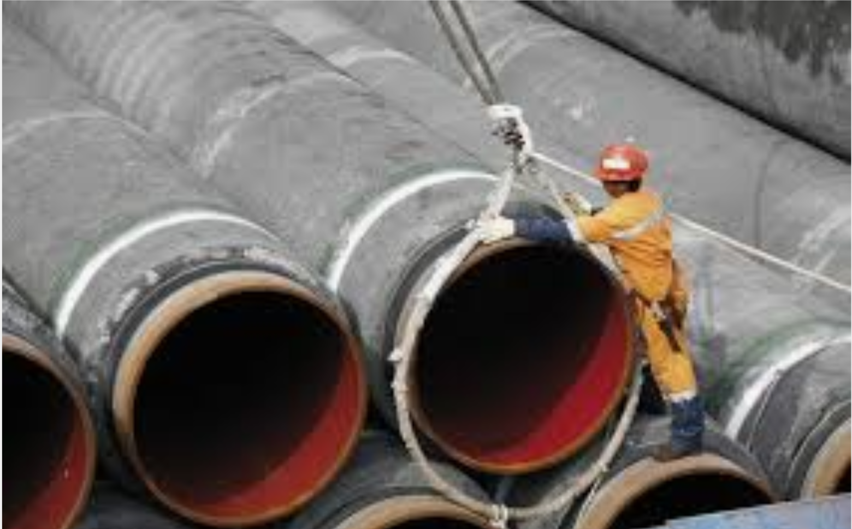
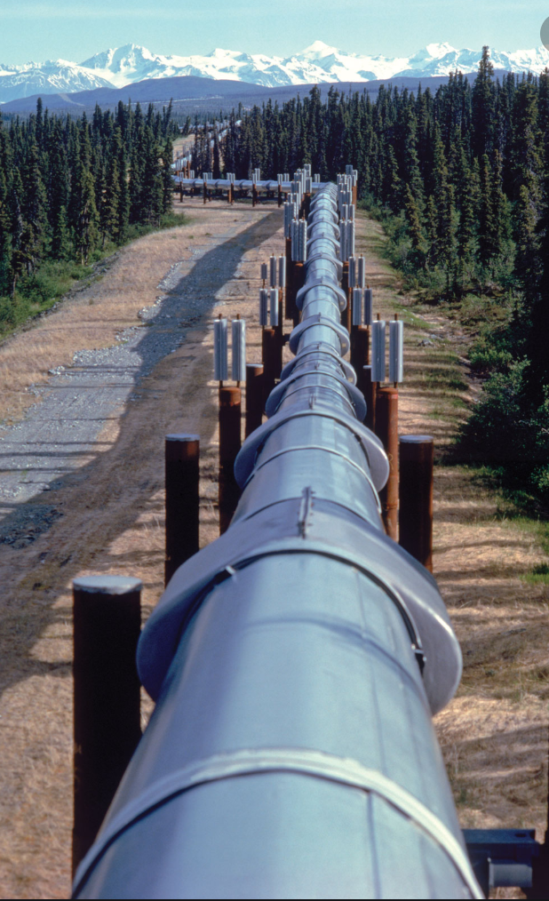
The following image is a pipeline used to transport oil from Alberta to BC. The diameter of the pipe is about 1.5m wide. In a stretch of 1km, how much oil can it hold?

Slide 7
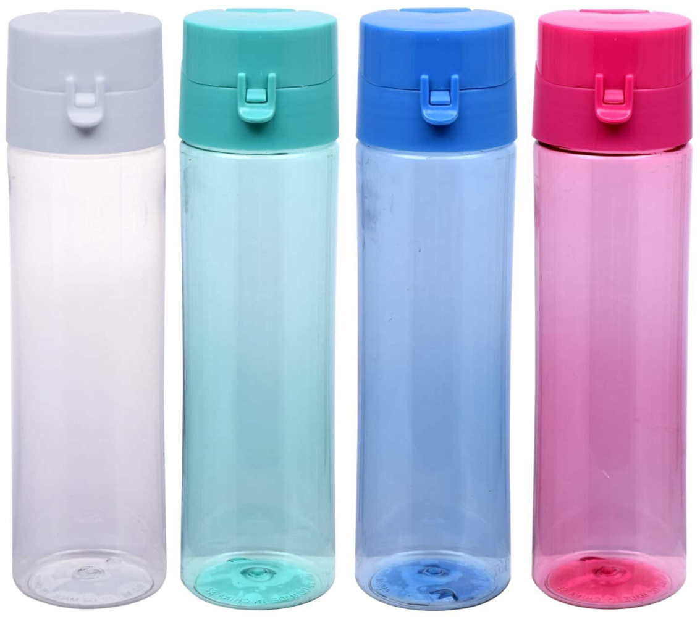
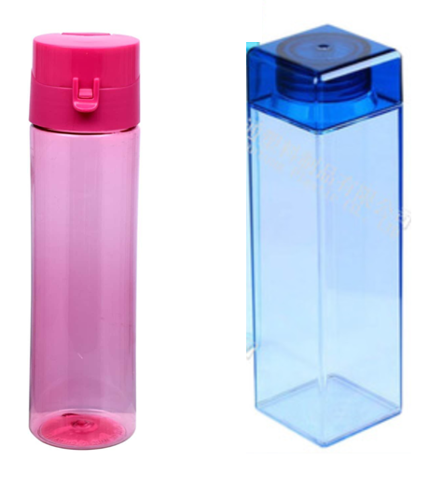
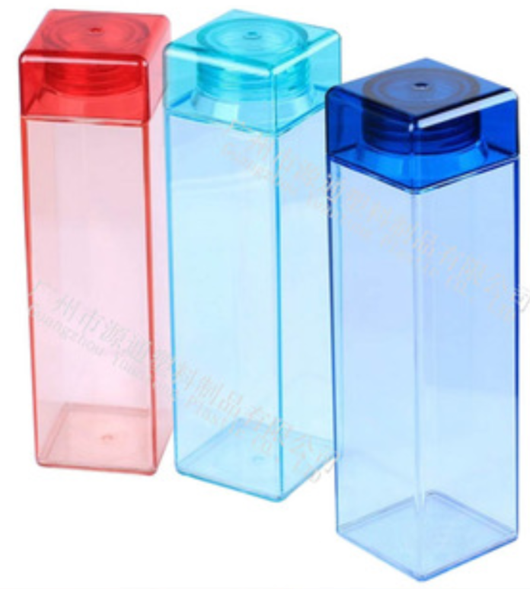
You head to 7-11 to buy slurpee and you allowed to bring your own bottle. Which bottle would get you more slurpee?

Slide 8
Q: What is the volume of the following solids?

Slide 9
Ex: Jason lives in an expensive mansion with a pool in the backyard. The pool is in the shape of a semi-cylinder. What is the volume of the pool?
The pool is in the shape of a cylinder
The volume is half a cylinder
The radius is 4m and the height is 12m
© Copyright all rights reserved to Homework depot: www.BCMath.ca

Slide 10
Ex: The following image is a hollow cylinder made of copper. The length “L” is 150cm. The inner radius is 3cm and outer radius is 4.5cm. If the density of copper is 8.94g/cm3, how much would this hollow cylinder weigh?

